Slide 1
Introduction to AMBER FF
SHUG-2015
Jose M. Borreguero
Neutron Data Analysis and Visualization Division
Center for Accelerating Materials Modelling

Slide 2
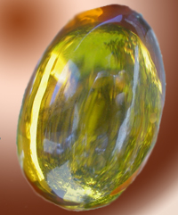
A bit of general info
http://ambermd.org
The AMBER MD group hosts three independent packages
equation solver + system environment ($$$)
various force-fields (free)
analysis tools (free)
Yearly releases

Slide 3
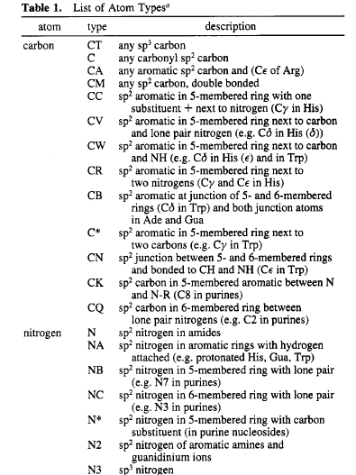
Atom types
Nuclei → Atoms with properties dependent on their chemical environment
1 element, many types !
Orb. hybridization → number of covalent bonds
polarization → fractional valence charges
charge fluctuations → Van der Waals parms.

Slide 4
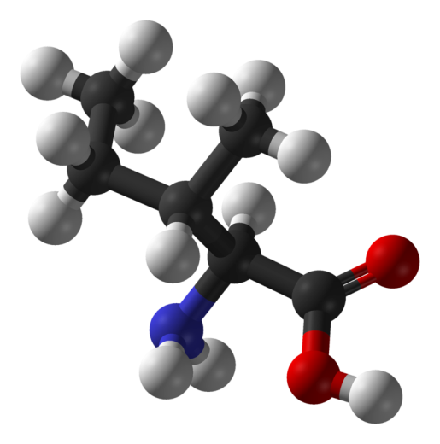
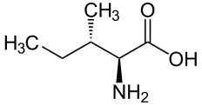
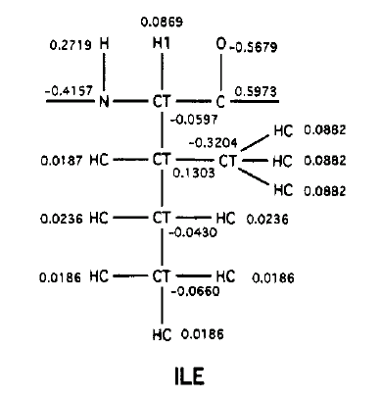
Atom types
Example: Isoleucine amino acid

Slide 5
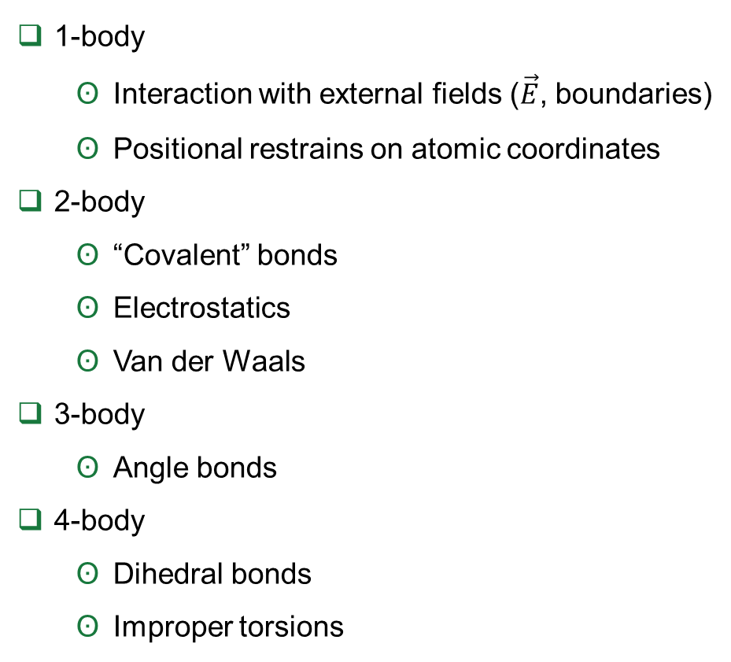
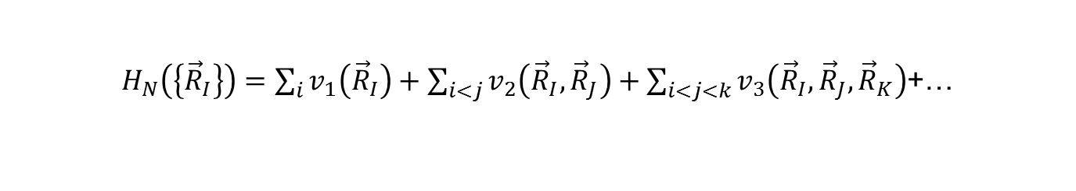
Expansion in multi-body terms
$H_{N}\left(\left\{{\vec{R}}_{I}\right\}\right)=\sum_{i}{v_{1}\left({\vec{R}}_{I}\right)}+\sum_{i<j}{v_{2}\left({\vec{R}}_{I},{\vec{R}}_{J}\right)}+\sum_{i<j<k}{v_{3}\left({\vec{R}}_{I},{\vec{R}}_{J},{\vec{R}}_{K}\right)}$+…
1-body
Interaction with external fields ($\vec{E}$, boundaries)
Positional restrains on atomic coordinates
2-body
“Covalent” bonds
Electrostatics
Van der Waals
3-body
Angle bonds
4-body
Dihedral bonds
Improper torsions

Slide 6
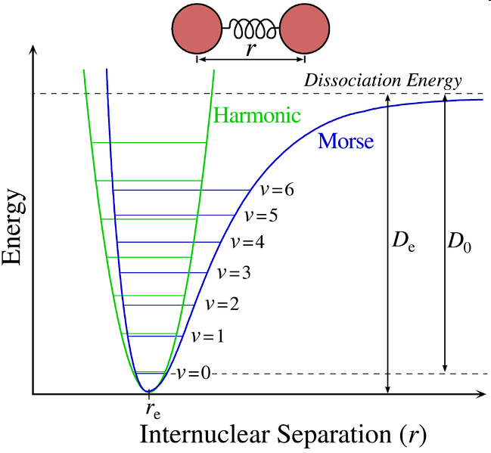
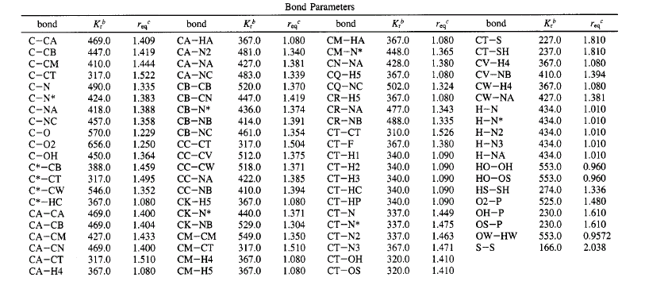
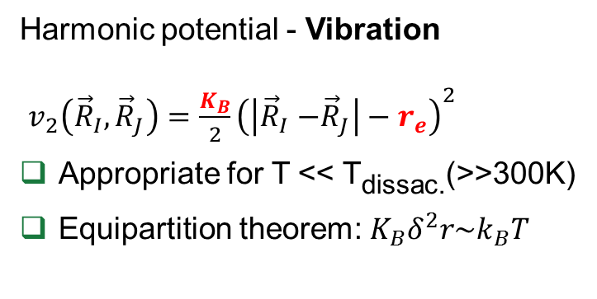
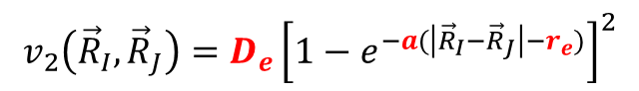
2-body: “covalent” bond
Harmonic potential - Vibration
$v_{2}\left({\vec{R}}_{I},{\vec{R}}_{J}\right)=\frac{K_{B}}{2}{\left(\left|{\vec{R}}_{I}{−\vec{R}}_{J}\right|−r_{e}\right)}^{2}$
Appropriate for T << T_{dissac.}(>>300K)
Equipartition theorem: $K_{B}δ^{2}r\sim k_{B}T$
For T << T_{dissac} use the Morse potential:
$$v_{2}\left({\vec{R}}_{I},{\vec{R}}_{J}\right)=D_{e}{\left[1−e^{−a(\left|{\vec{R}}_{I}{−\vec{R}}_{J}\right|−r_{e})}\right]}^{2}$$
Example of parameterization:
(Kcal/molÅ²)

Slide 7
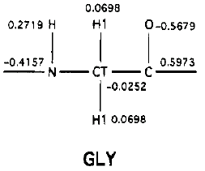
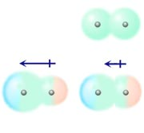
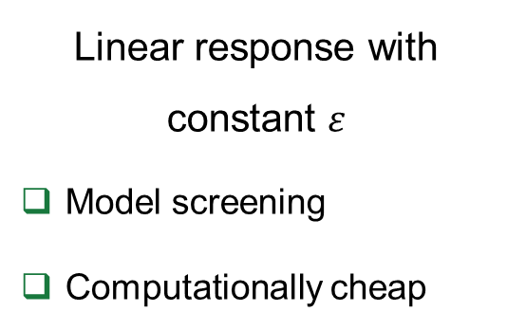
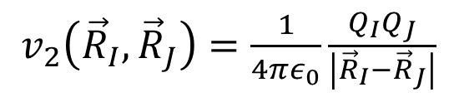
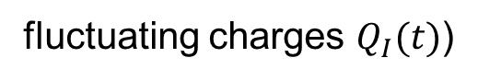
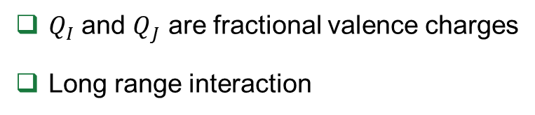
2-body: Electrostatics
$v_{2}\left({\vec{R}}_{I},{\vec{R}}_{J}\right)=\frac{1}{4πε_{0}}\frac{Q_{I}Q_{J}}{\left|{\vec{R}}_{I}{−\vec{R}}_{J}\right|}$
$Q_{I}$ and $Q_{J}$ are fractional valence charges
Long range interaction
Controls unbound diffusion
Models can get more complicated
fluctuating charges $Q_{I}(t)$)
Linear response with constant $ε$
Model screening
Computationally cheap
Computationally expensive

Slide 8
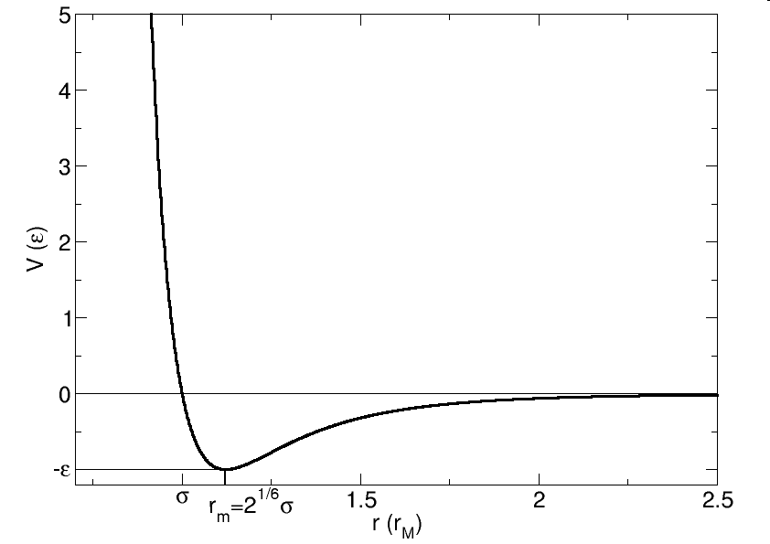
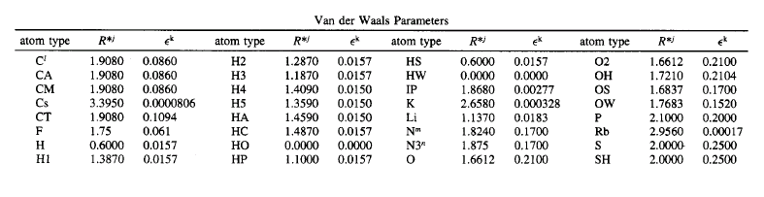
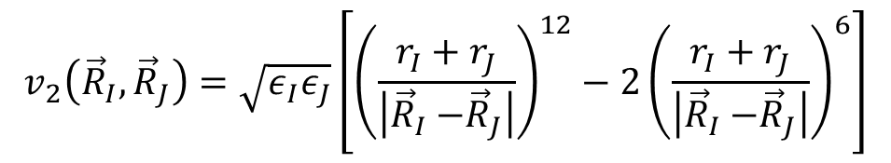
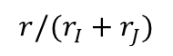
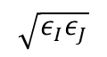
2-body: Van der Waals
$$v_{2}\left({\vec{R}}_{I},{\vec{R}}_{J}\right)=\sqrt{ε_{I}ε_{J}}\left[{\left(\frac{r_{I}+r_{J}}{\left|{\vec{R}}_{I}{−\vec{R}}_{J}\right|}\right)}^{12}−2{\left(\frac{r_{I}+r_{J}}{\left|{\vec{R}}_{I}{−\vec{R}}_{J}\right|}\right)}^{6}\right]$$
12-term ← electron cloud overlap
6-term ← fluctuating dipole-dipole interactions
short-range
$$\sqrt{ε_{I}ε_{J}}$$
Controls unbound diffusion
$$r/(r_{I}+r_{J})$$
Example of parameterization:

Slide 9
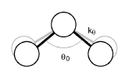
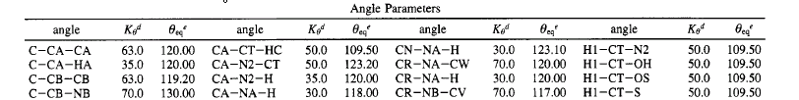
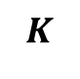
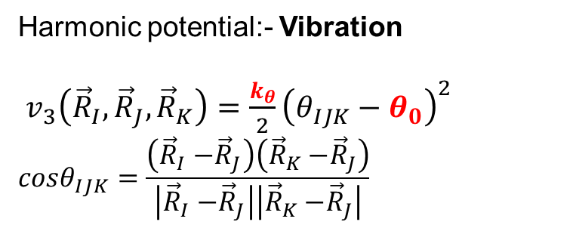
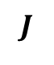
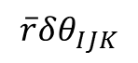
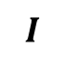
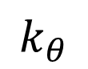
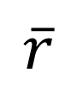
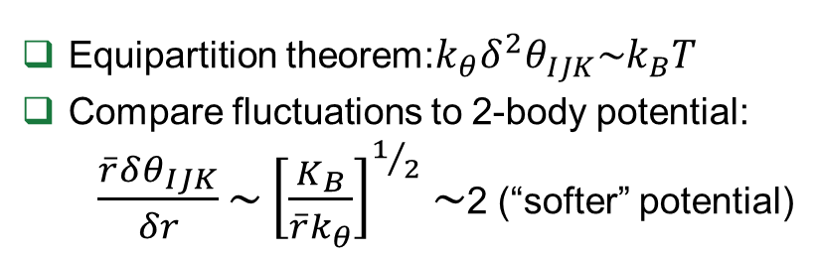
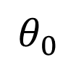
3-body: “angle bending”
Harmonic potential:- Vibration
$v_{3}\left({\vec{R}}_{I},{\vec{R}}_{J},{\vec{R}}_{K}\right)=\frac{k_{θ}}{2}{\left(θ_{IJK}−θ_{0}\right)}^{2}$
$$cosθ_{IJK}=\frac{\left({\vec{R}}_{I}{−\vec{R}}_{J}\right)\left({\vec{R}}_{K}{−\vec{R}}_{J}\right)}{\left|{\vec{R}}_{I}{−\vec{R}}_{J}\right|\left|{\vec{R}}_{K}{−\vec{R}}_{J}\right|}$$
$$J$$
$$k_{θ}$$
$$\overline{r}$$
Equipartition theorem:$k_{θ}δ^{2}θ_{IJK}\sim k_{B}T$
Compare fluctuations to 2-body potential:
$\frac{\overline{r}δθ_{IJK}}{δr}\sim {\left[\frac{K_{B}}{{\overline{r}k}_{θ}}\right]}^{1/2}\sim$2 (“softer” potential)
$$I$$
$$θ_{0}$$
$$K$$
$$\overline{r}δθ_{IJK}$$
Example of parameterization:
(Kcal/mol)

Slide 10
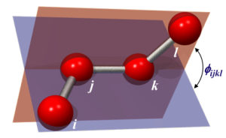
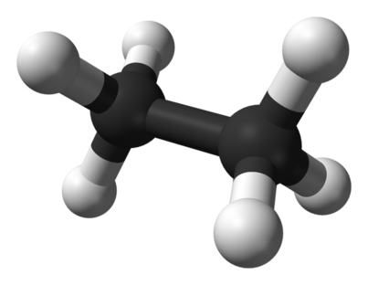
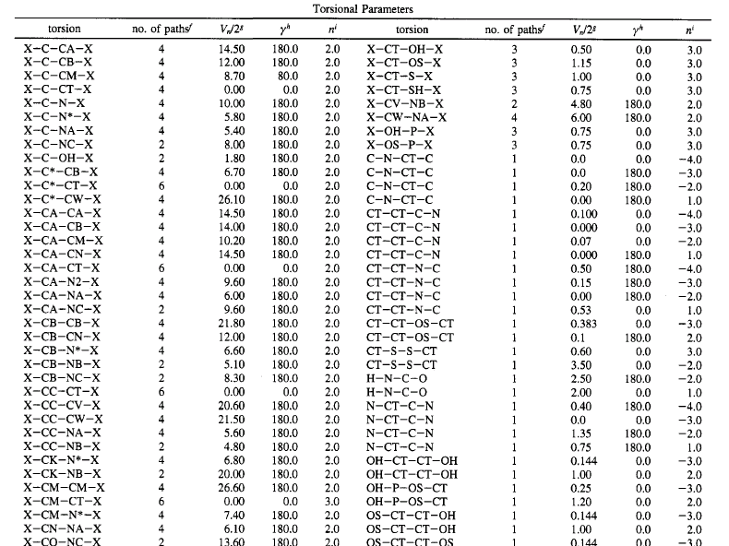
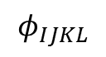
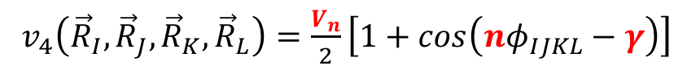
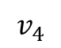
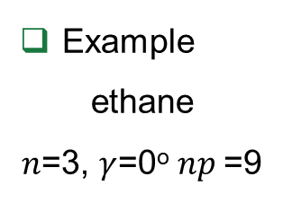
4-body: dihedral torsion
$v_{4}\left({\vec{R}}_{I},{\vec{R}}_{J},{\vec{R}}_{K},{\vec{R}}_{L}\right)=\frac{V_{n}}{2}\left[1+cos\left(nφ_{IJKL}−γ\right)\right]$
Controls localized jump-diffusion
Accounts for most of the configurational entropy of molecules
Example
ethane
$n$=3, $γ$=0º $np$=9
$$v_{4}$$
9 isomeric paths
$$φ_{IJKL}$$
Example of parameterization:

Slide 11
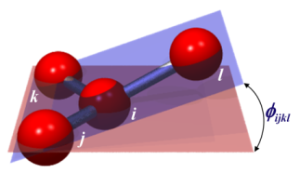
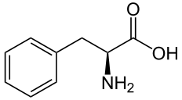
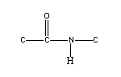
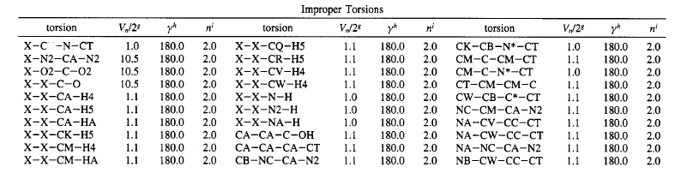
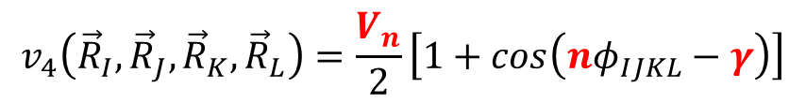
4-body: improper torsions
$$v_{4}\left({\vec{R}}_{I},{\vec{R}}_{J},{\vec{R}}_{K},{\vec{R}}_{L}\right)=\frac{V_{n}}{2}\left[1+cos\left(nφ_{IJKL}−γ\right)\right]$$
Controls localized diffusion
Enforces planarity.
Planar groups such as sp² hybridized carbons in carbonyl groups and in aromatic rings
Example of parameterization:

